Slide 1
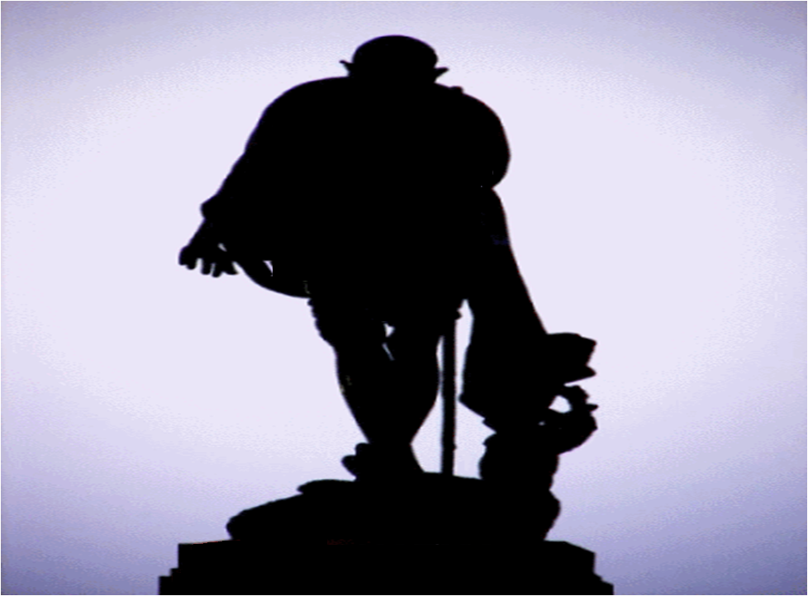

Slide 2
Why every corporate office stresses on leadership?
Why everyone talks so much about leadership capabilities?
Why leadership is so important?
What is Leadership?
Why should I focus on leadership?
Why in all management schools ‘Leadership’ is taught as a separate subject?

Slide 3
Global Terrorism
Growing Poverty
Uncontrolled Population Growth
Global Warming
730 established religions in the world
Depleting Energy Reserves
Global Economic Crisis
How can my business survive in this tough, challenging & ever changing markets
How can we make this world a better place to live?
How can we stop further deterioration of our habitat and human values?
What does humanity need in such an environment?
196 countries
6800 – 6900 distinct languages in the world
7054721028 – world population

Slide 4

For my business I need people who
, , ,
,
can take initiatives
can generate innovative ideas
have courage to take risks
have ability to manage people
have long term vision
For my society I need people who
can take initiatives, have courage to stand against wrong, have the ability to manage people, can generate innovative ideas, have long term vision
stand against wrong

Slide 5
A lot of research has been done to answer – Can leaders be made?
Yes leaders can be made
And the answer to which most people agree is- YES
BUT HOW?
By studying behavior, habits, and traits of strong and effective leaders
And embracing the qualities that made them great leaders
Are leaders only born? Can leaders be made?
Okay ! So what does it take to become an effective leader?
Identifying what did they do different than others?

Slide 6
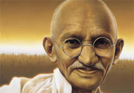
Lets study the life of such a great leader and see what lessons could be learnt
But, Why Gandhi?
Gandhi is considered as one of the most influential leaders. Without any official position, power or money, from humble beginnings he gained world prominence, helped achieve freedom and left a lasting legacy for us all. Many of Gandhi’s core principles are remarkably relevant in the realm of leadership competencies and self-development
Lord Mountbatten, the last viceroy of British India remarked about his stature and charismatic personality as ‘one-man boundary force’

Slide 7
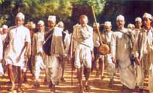
Lesson 1: Continuous learning and improvement
Gandhi always told that if two of his sentences contradicted each other, please accept the second one and forget the first one. This reflects –
learning and growth mindset
anticipation of follower’s needs
rigid consistency was NOT one of his traits

Slide 8
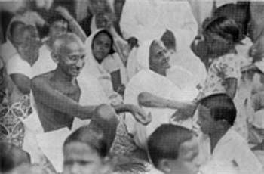
Lesson 2: Looking at each person just as a human being
“Be quick, be brief, be gone!” Personal meetings with Gandhi were very short. However Gandhi made people feel as if they were the only person in the world that Gandhi would have liked to talk at that time

Slide 9
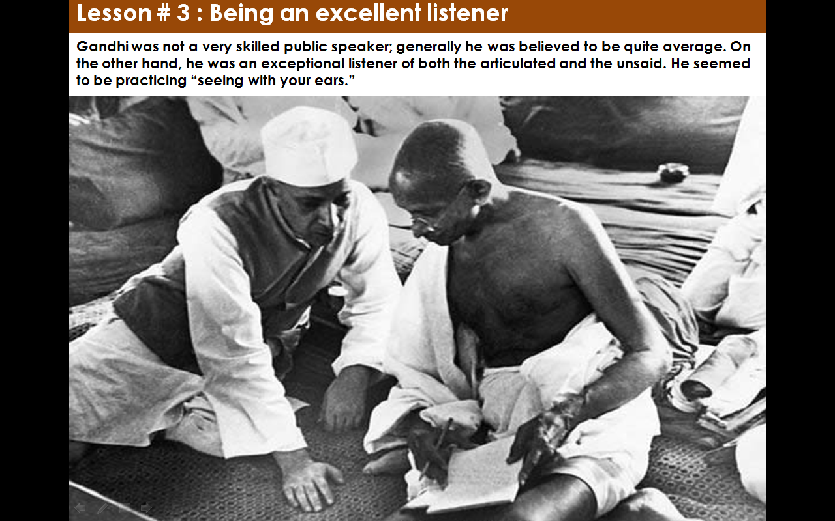
Lesson 3: Being an excellent listener
Gandhi was not a good orator, but people followed him because he practiced the principles of truth and non-violence in his life first and proved that any ordinary man can follow his path of truth and non-violence and then inspired others to follow these principles

Slide 10
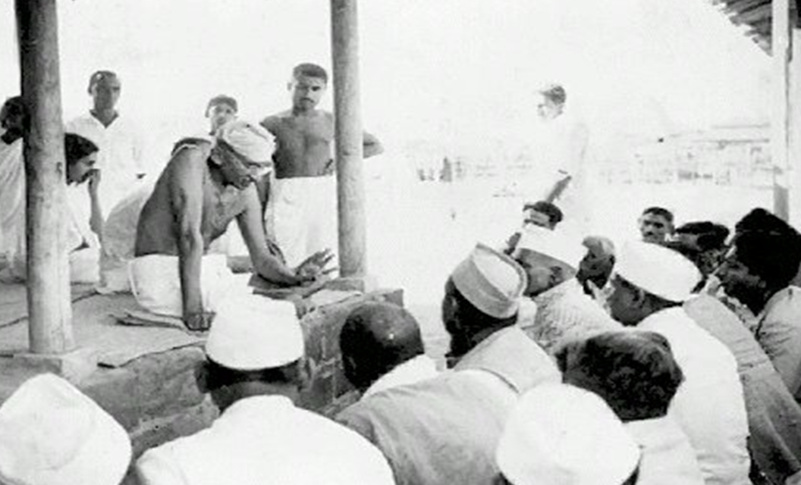
Lesson 4: Proactively identifying barriers to make sustainable change
Once a journalist asked Gandhi what was the biggest problem that India faced? He expected Gandhi to say slavery or British rule or pervasive poverty. But Gandhi said it was “callousness of intellectuals” . Gandhi had a long term vision of building a sustainable society and not just getting independence

Slide 11
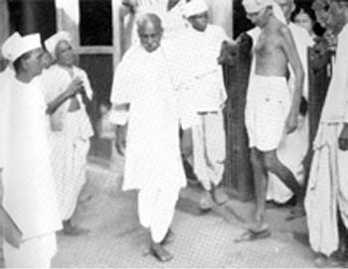
Lesson 5: Being the conscience keeper
Non cooperation was one of the key political movements that Gandhi initiated. Gandhi aborted the movement saying a key tenet of the movement – non-violence, was violated. He believed that the end did not justify the means.

Slide 12
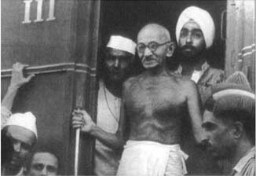
Lesson 6: Emphasis on self-awareness and discipline
As you grow in self awareness, you will better understand why you feel what you feel and why you behave as you behave. Self discipline is the training of your mind to control, perceived harmful, urges until a satisfactory solution has been sought

Slide 13
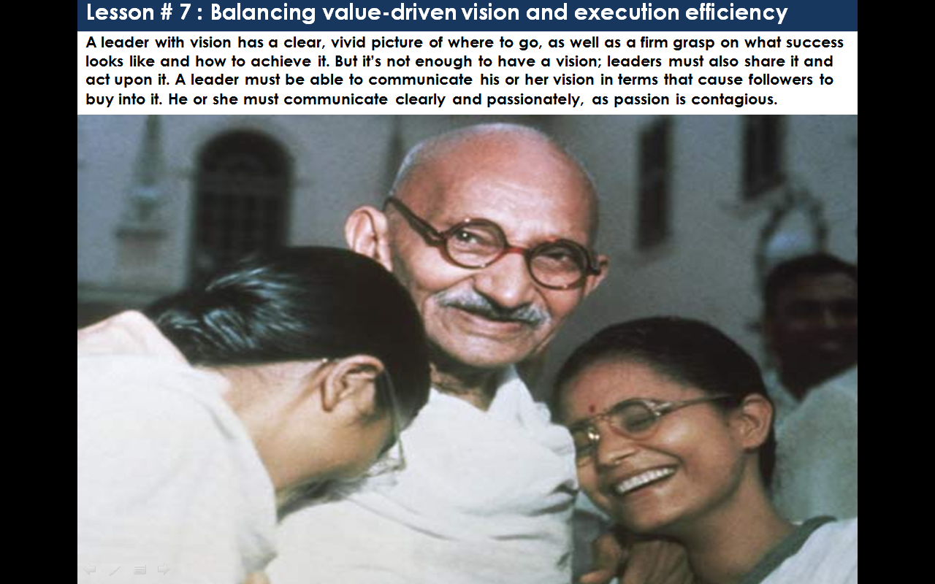
Lesson 7: Balancing value-driven vision and execution efficiency
A leader with vision has a clear, vivid picture of where to go, and a firm grip on what success looks like and how to achieve it. Leader must share the vision and act upon it. He must communicate it clearly and passionately.

Slide 14
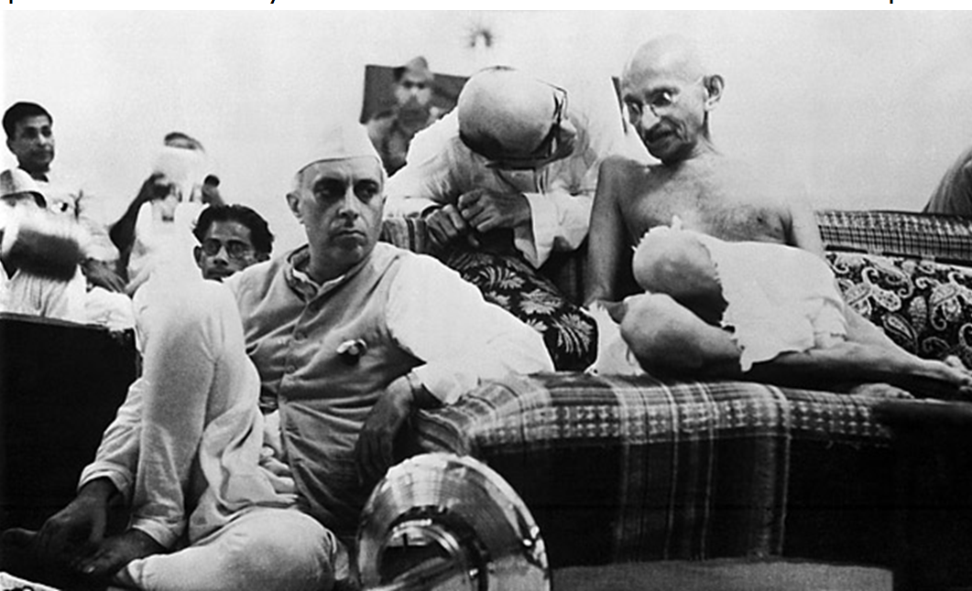
Lesson 8: Emphasis on path and result
Mahatma Gandhi was a great leader. He had chosen the path of non-violence for himself and his followers.

Slide 15
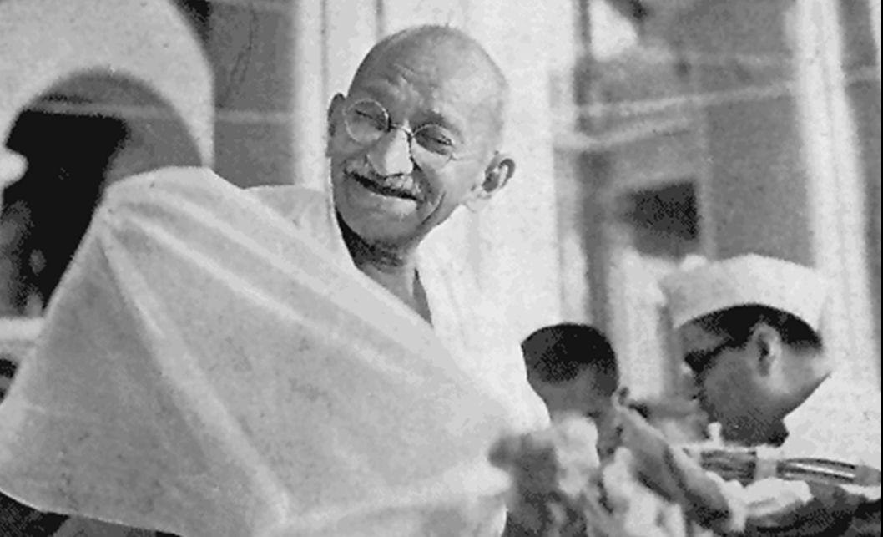
Lesson 9: Adopting a holistic perspective in every endeavor
Gandhi’s approach had always been holistic as human life is a synthetic whole, which cannot be divided into watertight compartments of social, political, religious life, etc. He is in favor of a non-violent and more civilized life style

Slide 16
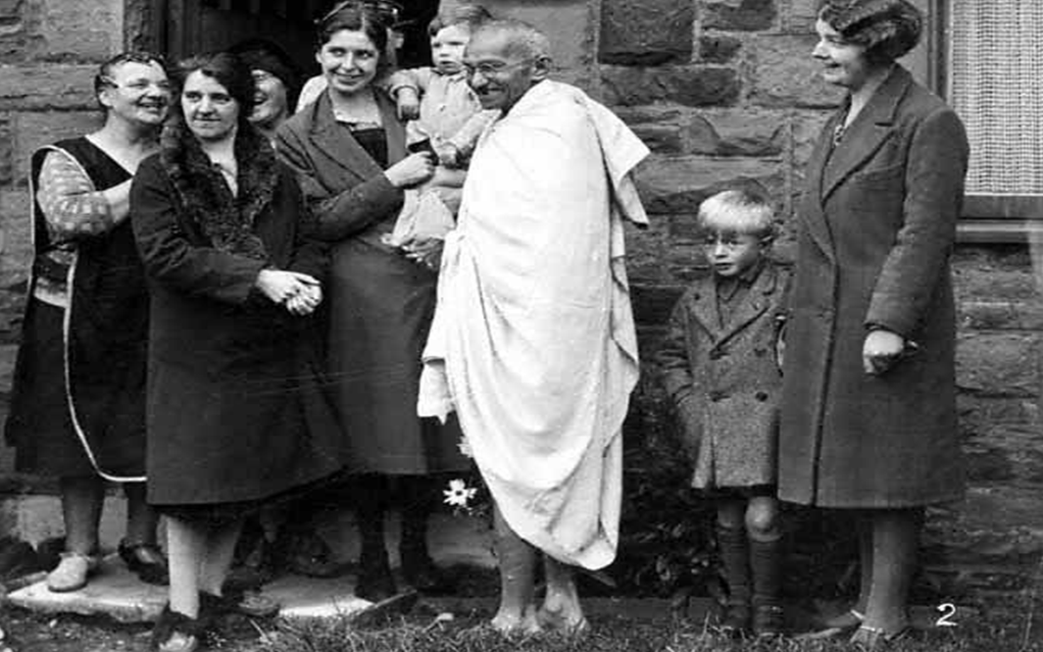
Lesson 10: Be open-minded
Always keep things in perspective. Do not dismiss other or anything- big or small- without giving a try. We never know where the next useful idea might come from.

Slide 17
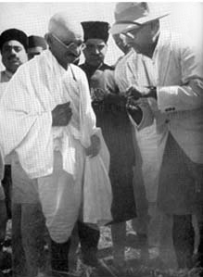
Lesson 11: Primus Inter Pares; What I practice is what I preach
An enduring leader is not a superior person, but only first among equals; first to abide by the moral code of conduct; first to bear the brunt of change; first to surrender privileges, and first to sacrifice one’s life. A leader is elected, chosen to serve and not installed to rule.

Slide 18
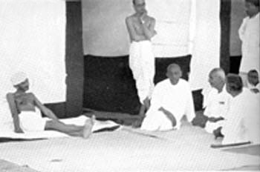
Lesson 12: Grass-root level contacts
A leader has to see that not many layers of hierarchies are created between him or her and the people at the lowest rung; and the people’s voice does not go unheard and doesn’t get distorted to the extent of even belying the truth

Slide 19
Gandhian Management
TRUTH
Gandhian Philosophy
NON-VIOLENCE
LOVE

Slide 20
Gandhian Management
When he initiated compromise between two opponents
– he was a mediator
When he applied his trident of truth, love and non-violence
-he was an uncompromising autocrat
When he gave procedural details to accomplish a goal
- he was a bureaucrat
When he delegated power to his colleagues or juniors
- he was a trainer and developer

Slide 21
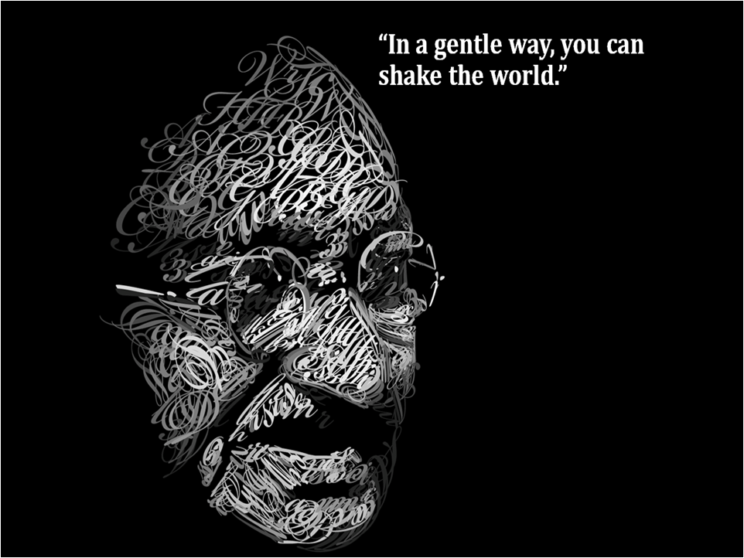
Gandhi was an ordinary man. But he did an extra-ordinary work by inspiring ordinary people.
Gandhi’s main quality was fearlessness. He achieved fearlessness and politeness by practising truth and non-violence.

Slide 22
References
http://wiki.answers.com/
http://howmanyarethere.net/
http://www.theleaderforge.com/
Visit us for more information at :- http://www.mkgandhi.org/
Bombay Sarvodaya Mandal / Gandhi Book Centre
299, Tardeo Road, Nana Chowk, Bombay 400007 India
Tel:91-22-2387 2061
Fax:91-22-2284 6870
Email: info@mkgandhi.org
Gandhi Research Foundation
Jain Agri Park, Jain Hills, Shirsoli Road,
Jalgaon, 425 001 MH India
Tel. +91-257-2260 011
www.gandhifoundation.net
Thank You

